Slide 1




Monsters of Dungeons and Dragons
Final Project Data Exploration

Slide 2






A Brief Introduction to D&D
D&D is a role-playing game with a Dungeon Master (DM) who creates a campaign (the world, the quests for characters, the monsters, etc.), and the players who create characters that play the campaign
Most D&D gameplay focuses on players battling against monsters
Players control their characters’ actions through dice rolls (typically a 20-sided dice) while the DM controls the monsters
Higher die rolls mean an action or attack is likely successful
Monsters have a “Challenge Rating” which is a representative score of a monster’s toughness in battle based on various “stats” such as ability scores, hit points, and armor class values
Basically, the DM can use the Challenge Rating to get a general sense for how challenging a monster is for their players to fight
Monsters
Characters

Slide 3
The Dataset and Cleanup
Sourced from Kaggle: https://www.kaggle.com/datasets/travistyler/dnd-5e-monster-manual-stats?select=cleaned_monsters_basic.csv
The data was sourced from the D&D guidebook
Dimension of original dataset: 324 rows x 45 columns
Clean up Process
Dropped non-essential rows (down to 324 rows x 16 columns)
Coded some columns to numeric (i.e. challenge rating, languages, and legendary creature)
Checked for obvious outliers in numeric variables
Saved new csv file that was used for analysis (monsters_cleaned.csv)

Slide 4
Data and Terminology Description
Armor Class: numeric value from 1 to 30 that describes how hard it is for a player to hit and cause damage to a monster (lower AC means the monster is easier to hit)
Hit Points: numeric value from 5 to 676 that describes the amount of damage a monster can take before it is killed (lower HP means a less hits will kill it)
Ability Scores: numeric values from 1 to 30 that describe:
Strength: a monster’s physical power
Dexterity: a monster’s agility and reflex skills
Wisdom: a monster’s perception, insight, or intuition
Intelligence: a monster’s memory, reasoning, or analytical skills
Constitution: a monster’s resilience and stamina
Charisma: a monster’s social skills and influence on others
Speed: numeric value between 0 and 60 ft (increments of 10) that represents a monster’s travel speed on land (base speed for humans is 30 ft, so anything above that is a fast monster)
Speak Language: a binary yes (1) or no (0) that represents if a monster can speak and/or understand any language
Legendary Creature: a monster that can perform extraordinary actions outside of the normal actions for most monsters

Slide 5
Data and Terminology Description (cont.)
Size: character variable describing the size of the monster (Tiny, Small, Medium, Large, Huge, or Gargantuan)
Type: character variable describing the type of monster (i.e. Dragon, Humanoid, etc.)
Alignment: a character variable that broadly describes a monster’s outlook towards society (Lawful, Neutral, or Chaotic) and their morals (Good, Neutral, or Evil). There can be any combination of the two scales, including a true neutral option
Lawful
Lawful Evil
Lawful Neutral
Lawful Good
Neutral Evil
Neutral
Neutral Good
Evil
Good
Chaotic Evil
Chaotic Neutral
Chaotic Good
Chaotic

Slide 6
Why did I make this app?
Creating a well-balanced fight between characters and monsters is difficult for many DMs (i.e. you probably do not want your 1st level players to fight against an adult dragon)
Thus, I wanted to make something that would make it easy to explore challenge rating of monsters and evaluate what other stats can help a DM plan a tough fight without killing all the players

Slide 7
Link to GitHub
https://github.com/odelmas-sci/824-final
README page:
File name: Monsters of DnD.R is the R script where I cleaned the data that I used in the Shiny app
File name: monsters_cleaned.csv is the csv file I saved of the cleaned data
File name: app.R is the Shiny App

Slide 8
The app: Monster Challenge Estimator
Tab 1: Introduces the user to each of the predictors against actual challenge rating individually
Tab 2: Introduces the monsters by plotting Challenge Rating (given by the game guidebook) against the Predicted Challenge Rating of the fitted model
Predictors for Challenge Rating:
Armor Class, Hit Points, Strength, Dexterity, Constitution, Intelligence, Wisdom, Charisma, Speed, Speak Languages, Legendary Creature
Can also filter by Monster Type
Tab 3: Principal Component Analysis (PCA) of Monster Types
Tab 4: Search for a monster and use it in your campaign!

Slide 9
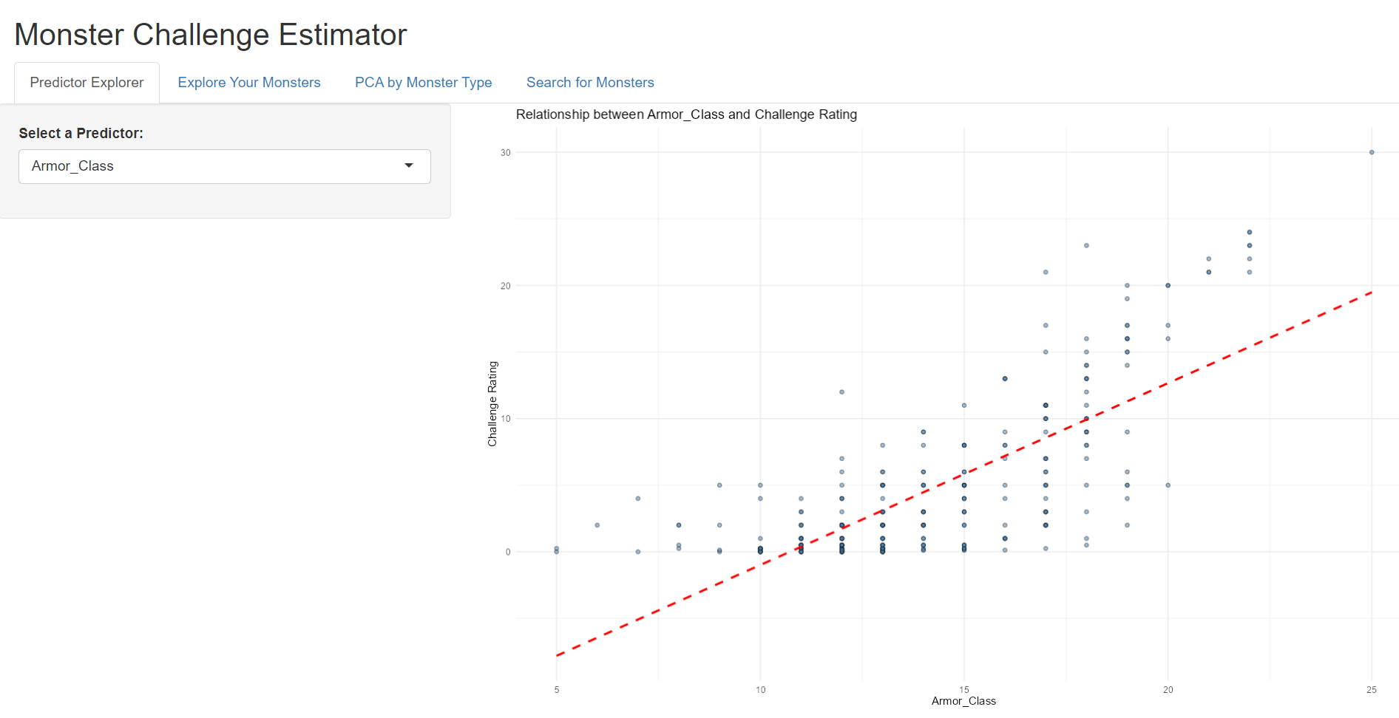
Tab 1: Predictor Explorer
Tab 1 is an introduction to exploring each predictor against challenge rating
The dropdown menu allows users to explore each of the predictors individually

Slide 10
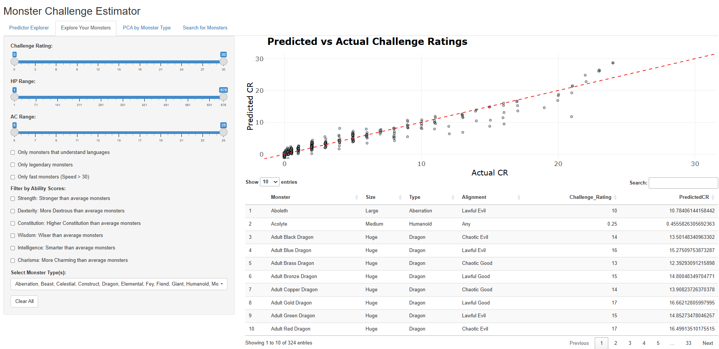
Tab 2: Explore Your Monsters
This is the page where the user can explore the monsters

Slide 11
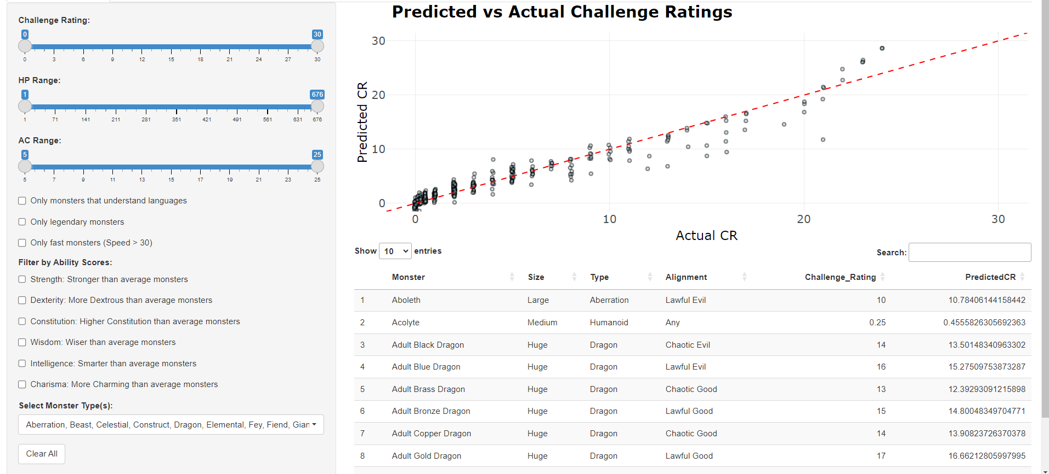
Tab 2: Explore Your Monsters (cont.)
The user can change any of the filters on the panel to see what monsters get filtered out (including monster type)
The table below shows the monsters that are being plotted in the graph
Clear All reverts the settings back to the default

Slide 12
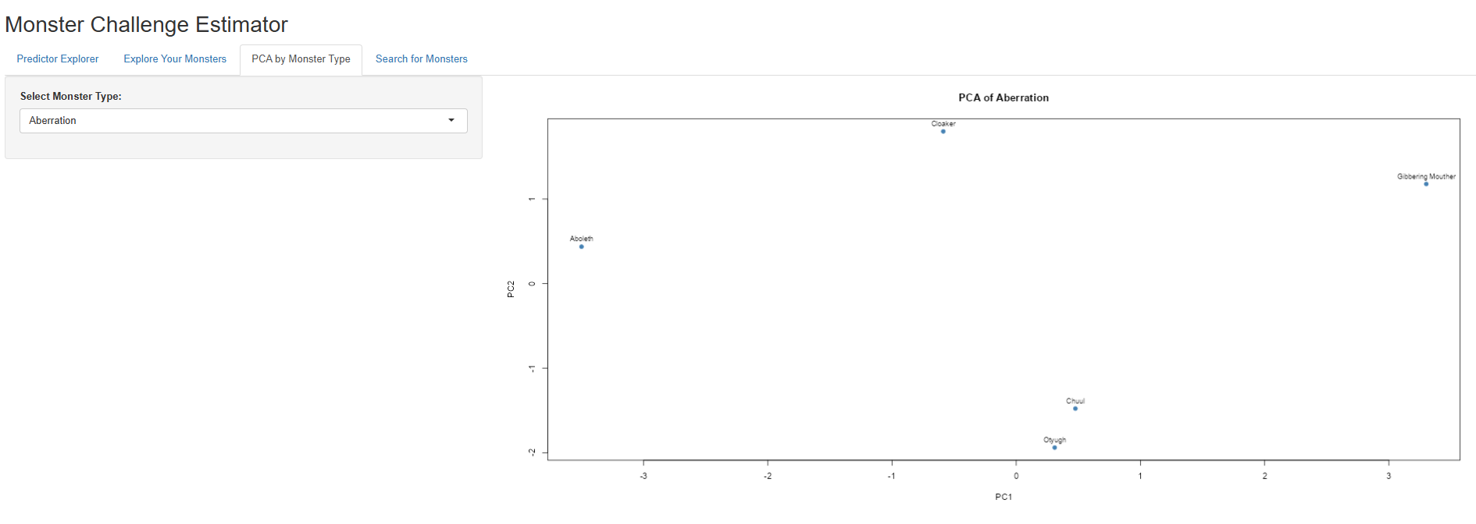
Tab 3: PCA by Monster Type
Tab 3 is about looking at the similarities between monsters within each monster type
The dropdown menu allows users to explore each monster type
The PCA plot can show if certain monster types behave similarly or it the DM needs to think more about how to incorporate the monster into the campaign (ex. Chuul and Otyugh have similar stats from other Aberration monsters)

Slide 13
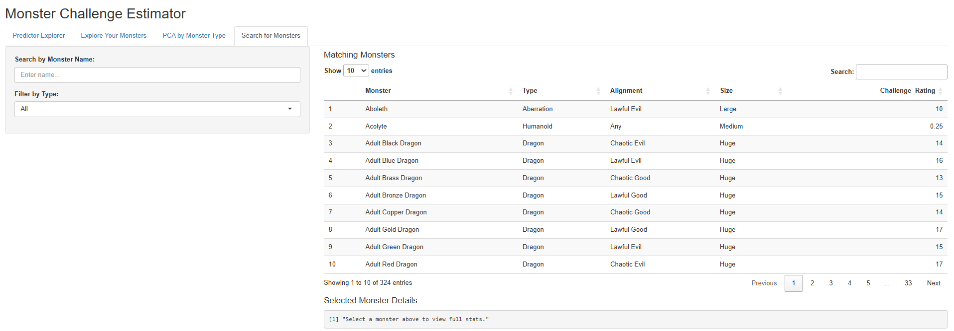
Tab 4: Search for Monsters
Finally, Tab 4 is where the user can search for whatever monster they want to use as a DM
The user can either search in the “Search by Monster Name” or Filter by Type and then select a monster

Slide 14
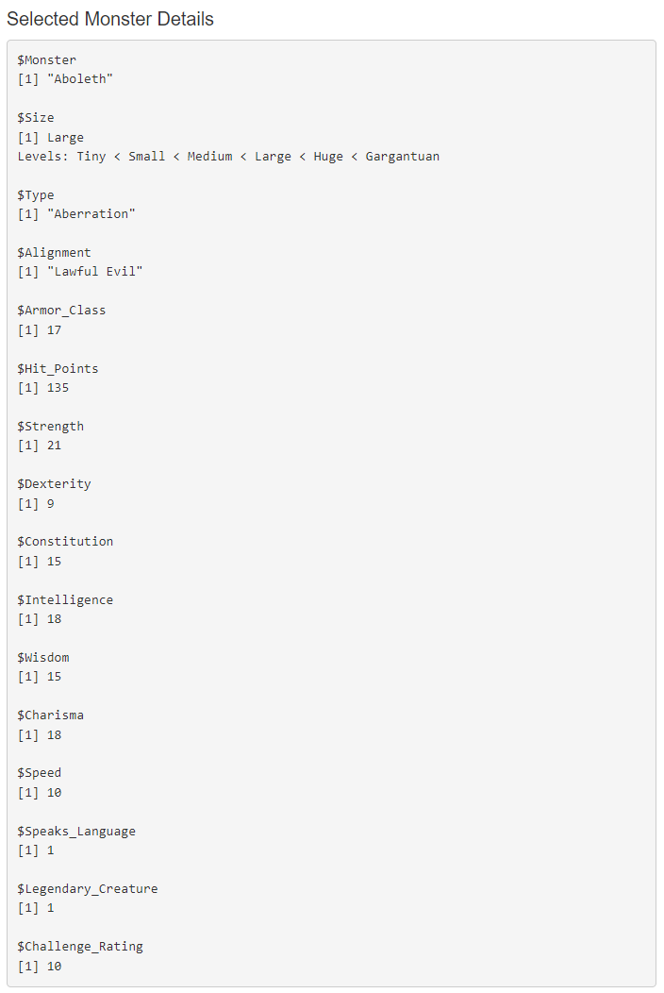
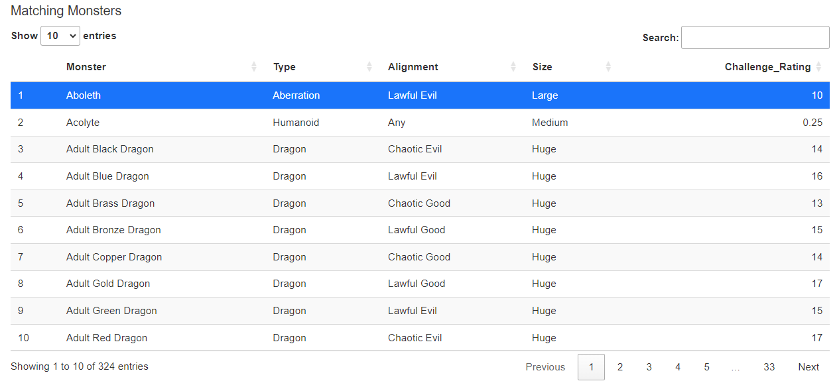
Tab 4: Search for Monsters (cont.)
The table is interactive, so the user can select a monster, and the full stats will appear below

Slide 15
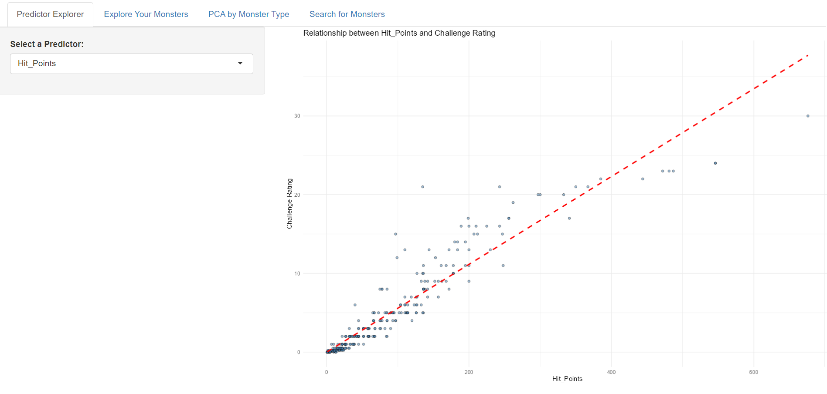
Example Use Case:
Let’s say for the campaign I’m running as a DM, the players (level 9) are trapped in a graveyard and I want them to fight off some Undead monster
I want to first look at what predictors will predict more challenging monsters, such as hit points
Now, I’m going to look for monsters with high hit points but maybe not the highest since my players are only level 9

Slide 16
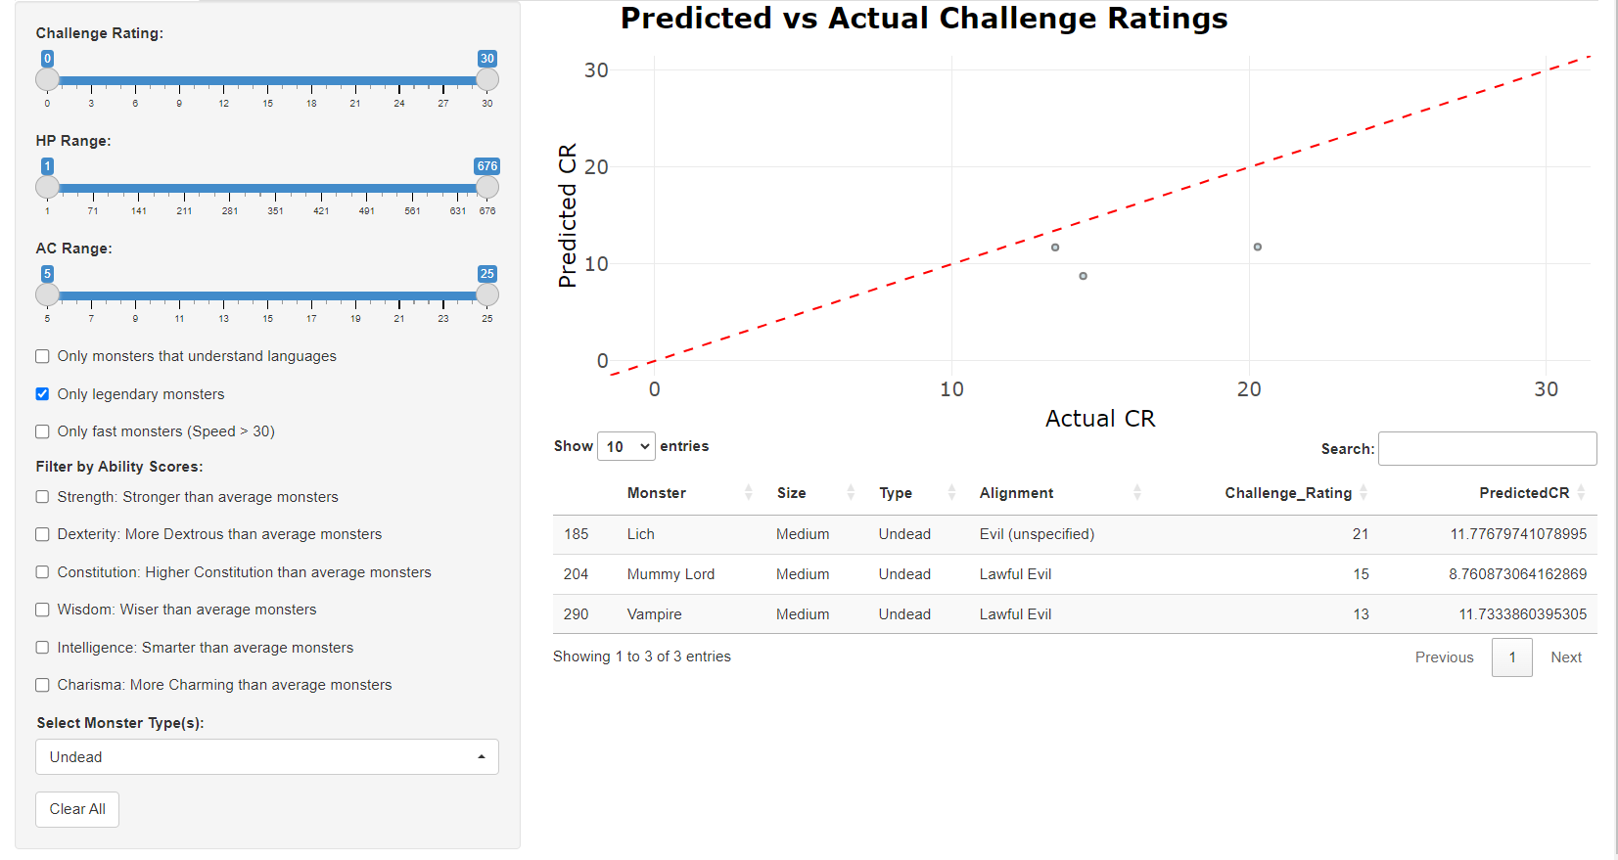
Example Use Case:
Next, I want to start filtering out which monsters I’d like to use in my graveyard fight, so I might want to look at Undead monster types
If I only want to make it a really challenging fight, then I’ll look at Legendary Creatures only, so the list is limited to these three: Lich, Mummy Lord, Vampire
These might be good candidates for my graveyard fight against my players!

Slide 17
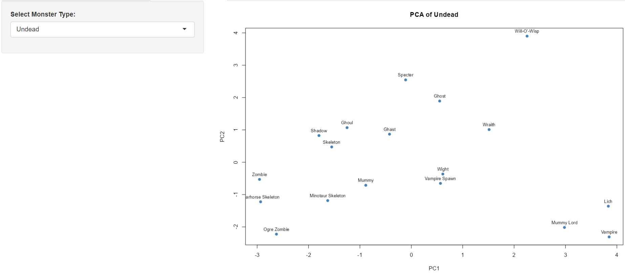
Example Use Case:
Next I can see from the PCA plot that these three will behave similarly in terms of their stats, so that gives me some flexibility to use a monster that best fits into my graveyard setting
I’d probably lean towards a Lich or Vampire, so now I’m down to 2 monsters

Slide 18
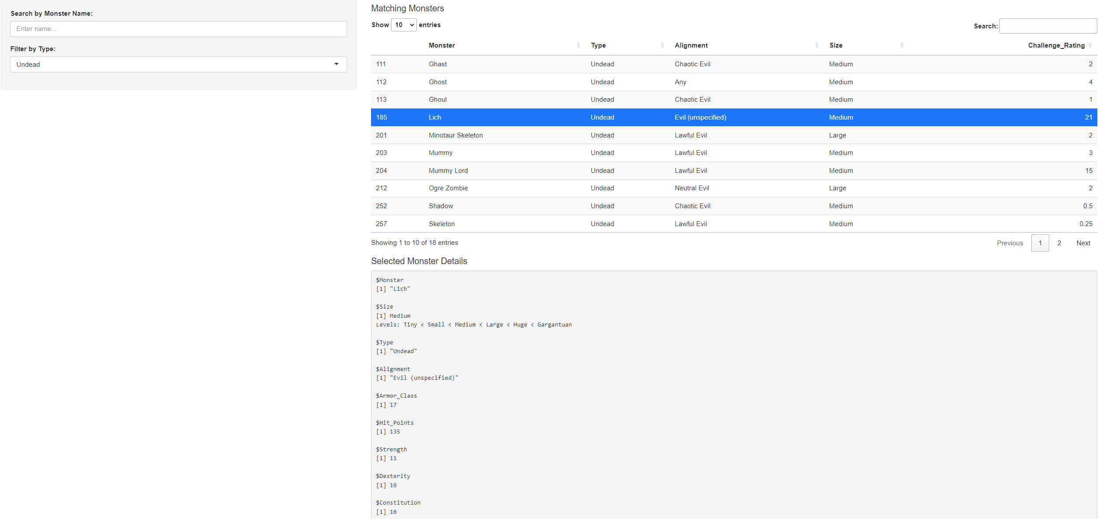
Example Use Case:
Finally, I use the fourth tab to compare the stats between the Lich and the Vampire, and I might go for the Lich to make it a really challenging fight for my players!

Slide 19
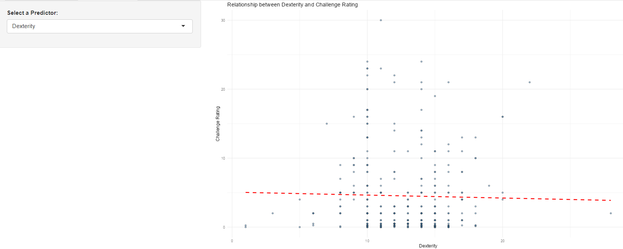
Interesting findings
For most of the predictors, there is a relationship between Challenge Rating and the predictor, except for Dexterity, which does not seem to have a strong relationship as Challenge Rating increases, so this stat doesn’t matter as much when picking a challenging monster

Slide 20
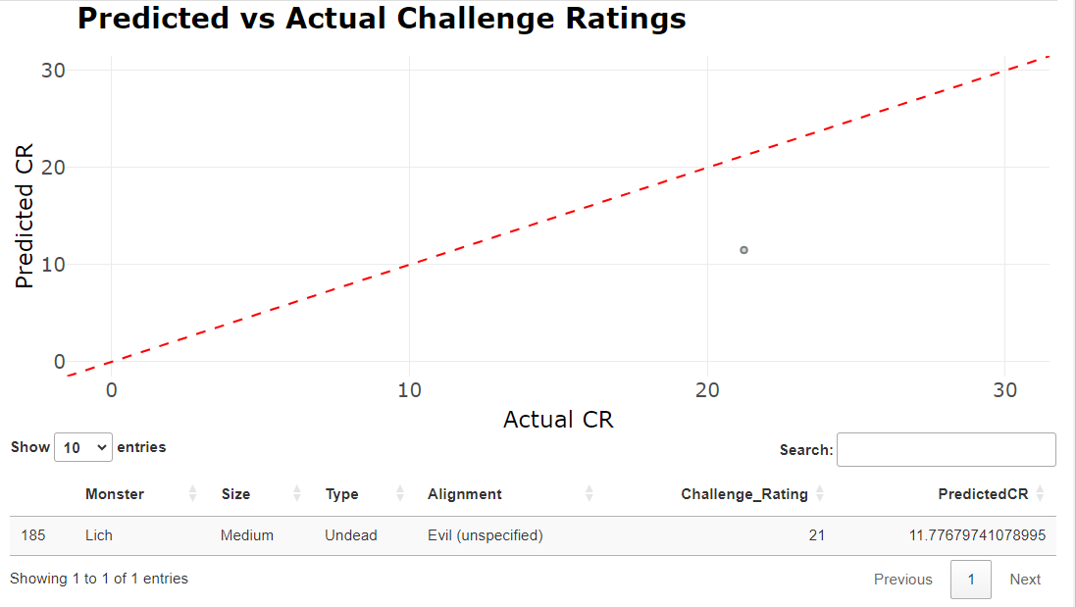
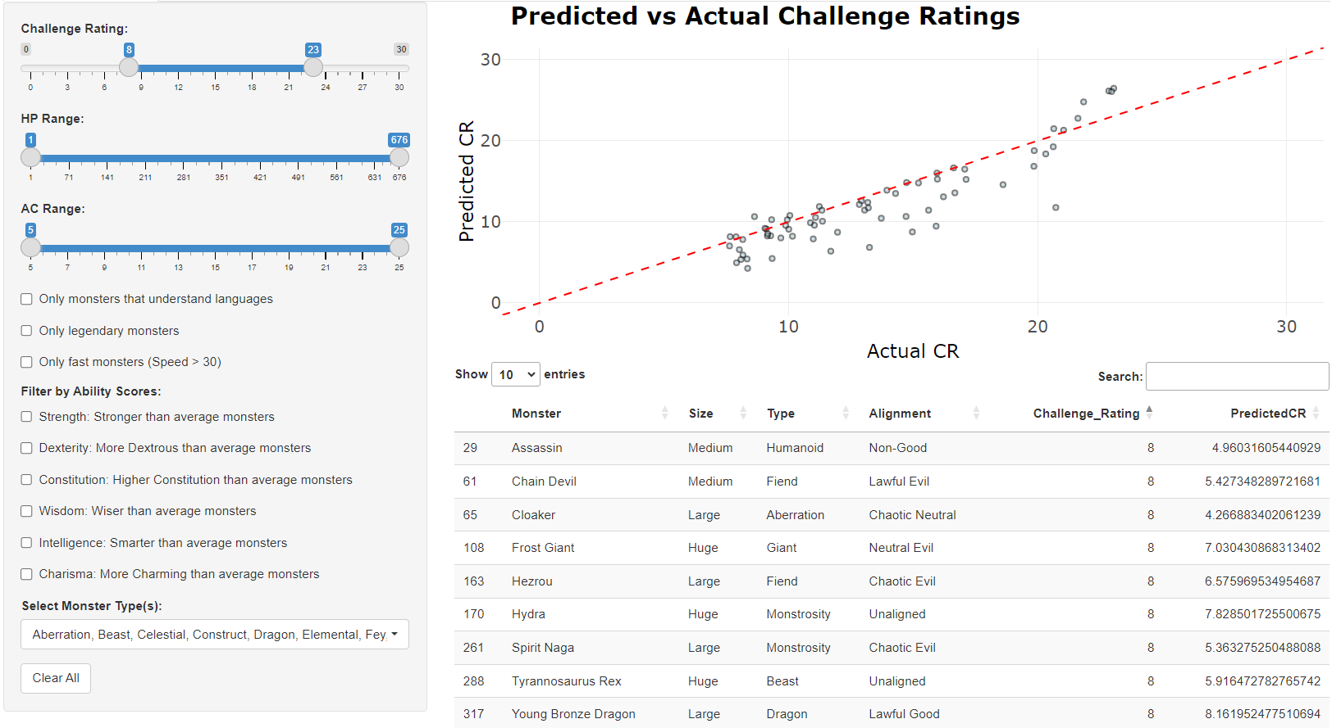
Interesting Findings (cont.)
It seems like there’s a chunk of monsters (circled in green) that the guidebook rates between 10 and 20 but the model gives a slightly lower predicted CR
Further, there is one monster (the Lich) that seems to be predicted even lower than the rest, and might be a potential outlier

Slide 21
Conclusions and Summary
This app is useful for DM’s interested in creating challenge monster interactions with their players’ characters by easily exploring monster stats
The PCA plot allows the user to look at how certain monsters are similar so that can be helpful when getting creative with the story
The interactive monster explorer tab is a great way to limit the list down to just a handful of monsters to use
Most of the predictors are related to challenge rating, except for perhaps dexterity which does not seem to correlate with Challenge Rating

Slide 22
Link to GitHub (another just in case!)
https://github.com/odelmas-sci/824-final
README page:
File name: Monsters of DnD.R is the R script where I cleaned the data that I used in the Shiny app
File name: monsters_cleaned.csv is the csv file I saved of the cleaned data
File name: app.R is the Shiny App

Slide 23

Happy fighting!

